Slide 1
SOCIAL MEDIA DASHBOARD

Slide 2
Front End Engineering-I Project
Team Details:
Arpit goel
Arvin
Arshvir Singh
Arsh Beri
Faculty Coordinator:
Dr. Chetna Kaushal
:
Chitkara University Institute of Engineering and Technology,
Chitkara University, Punjab

Slide 3
Table of Contents
Introduction
Problem Statement
Technical Details
Key Features
Project Highlights
Bonus Feature(optional)
Conclusion
References/Links used

Slide 4
Introduction
SOCIAL MEDIA DASHBOARD
Welcome to our project, where we've leveraged the capabilities of HTML and CSS to craft a Social Media Dashboard. This dashboard provides a user-friendly and visually engaging way to monitor and manage social media data, making the task of tracking online presence and engagement seamless and efficient.

Slide 5
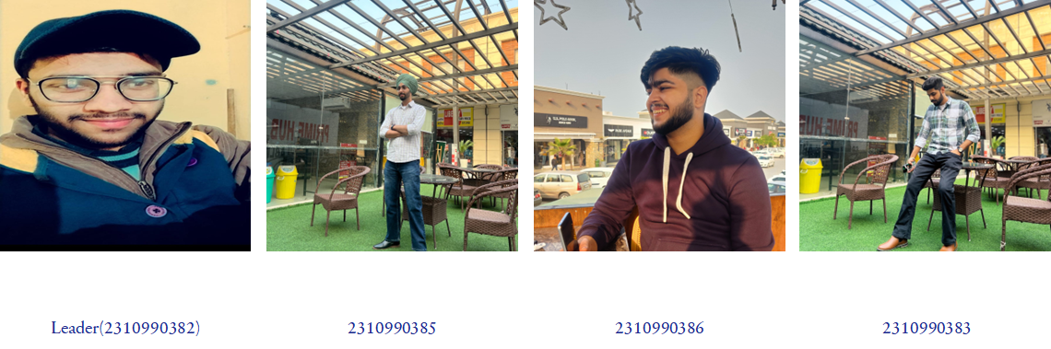
Introduction
MEET OUR TEAM
​

Slide 6
Problem Statement
Organizations and individuals need a centralized solution to effectively monitor and make informed decisions based on their social media presence.
Extensive research reveals that existing social media management tools often lack user-friendliness and customization.
Users struggle to extract meaningful insights from their data, hindering their ability to strategize and engage effectively with their audience.
Project Aim:
Our project aims to address this challenge by developing a user-friendly and customizable Social Media Dashboard using HTML and CSS. This dashboard will empower users to effortlessly visualize, analyze, and manage their social media data, ultimately enhancing their online presence and decision-making capabilities.

Slide 7
Technical Details
Front-end Technologies:
→ HTML: Used for structuring the web page and creating elements.
→ CSS: Applied for styling and layout design, including responsive design for various screen sizes.
Dashboard Components:
Divs and Containers: For organizing and structuring dashboard sections.
Tables: Displaying detailed data in a tabular format.
Stylish UI Elements: Icons and other UI components for user interaction.

Slide 8
Key Features
Easy for Everyone:
Designed so anyone can use it, no tech skills required.
Safety First:
Your data and info are protected.
Attractive Design:
Create an appealing and visually pleasing that aligns with the website’s Interface and style.
Performance Optimization:
Ensure fast loading times and smooth user interactions.

Slide 9
Project Highlights

Slide 10
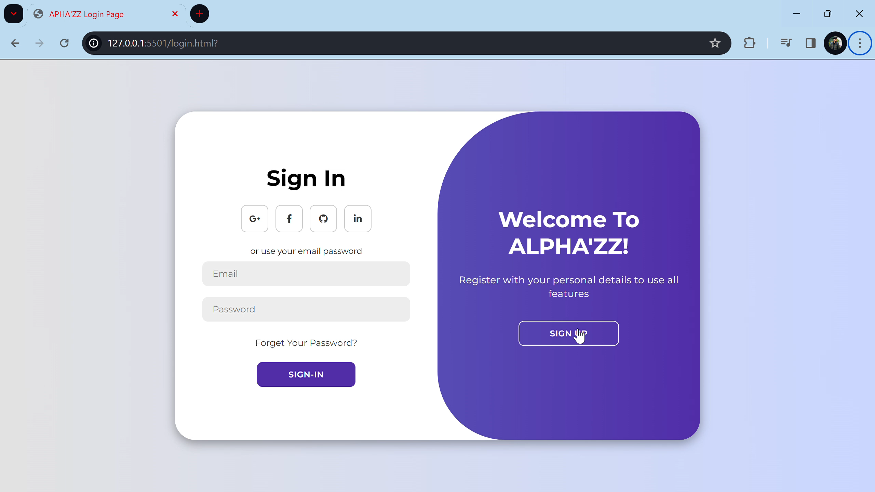
SIGN IN-PAGE OVERVIEW

Slide 11
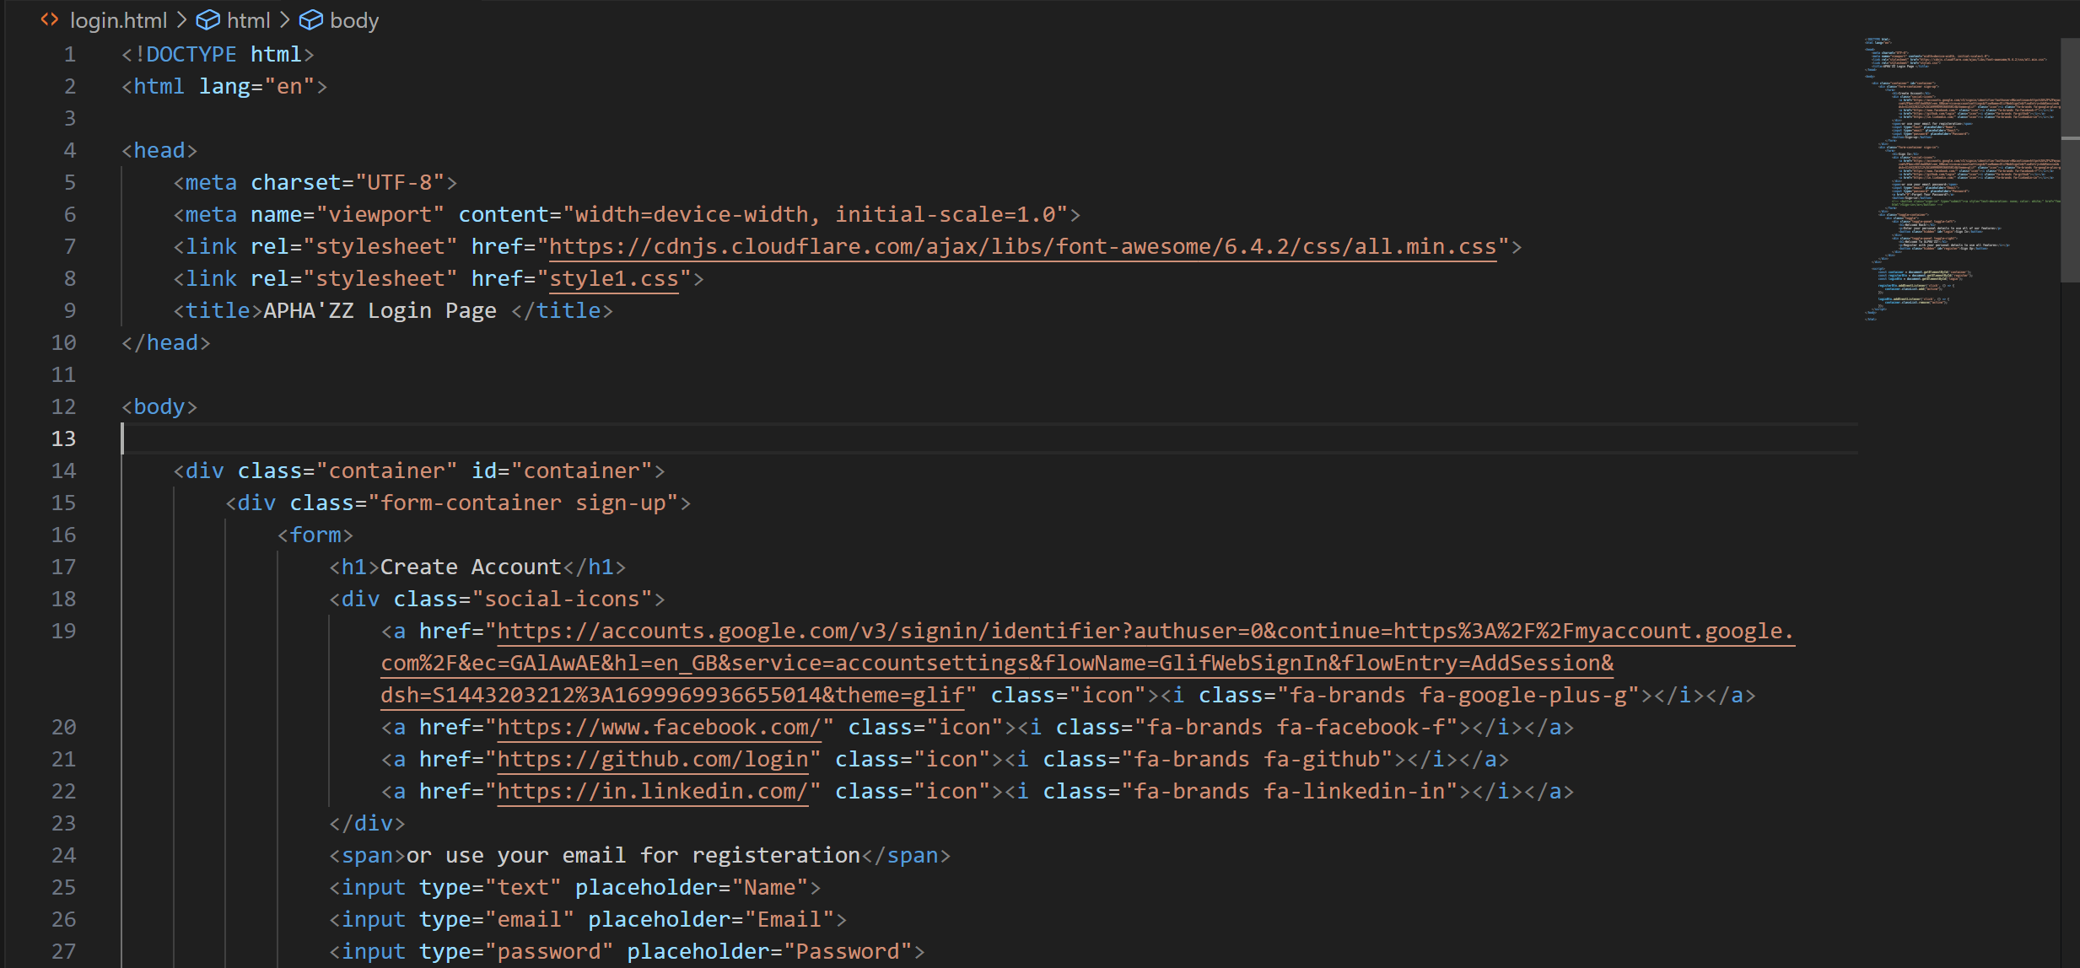
Html Code Highlights

Slide 12
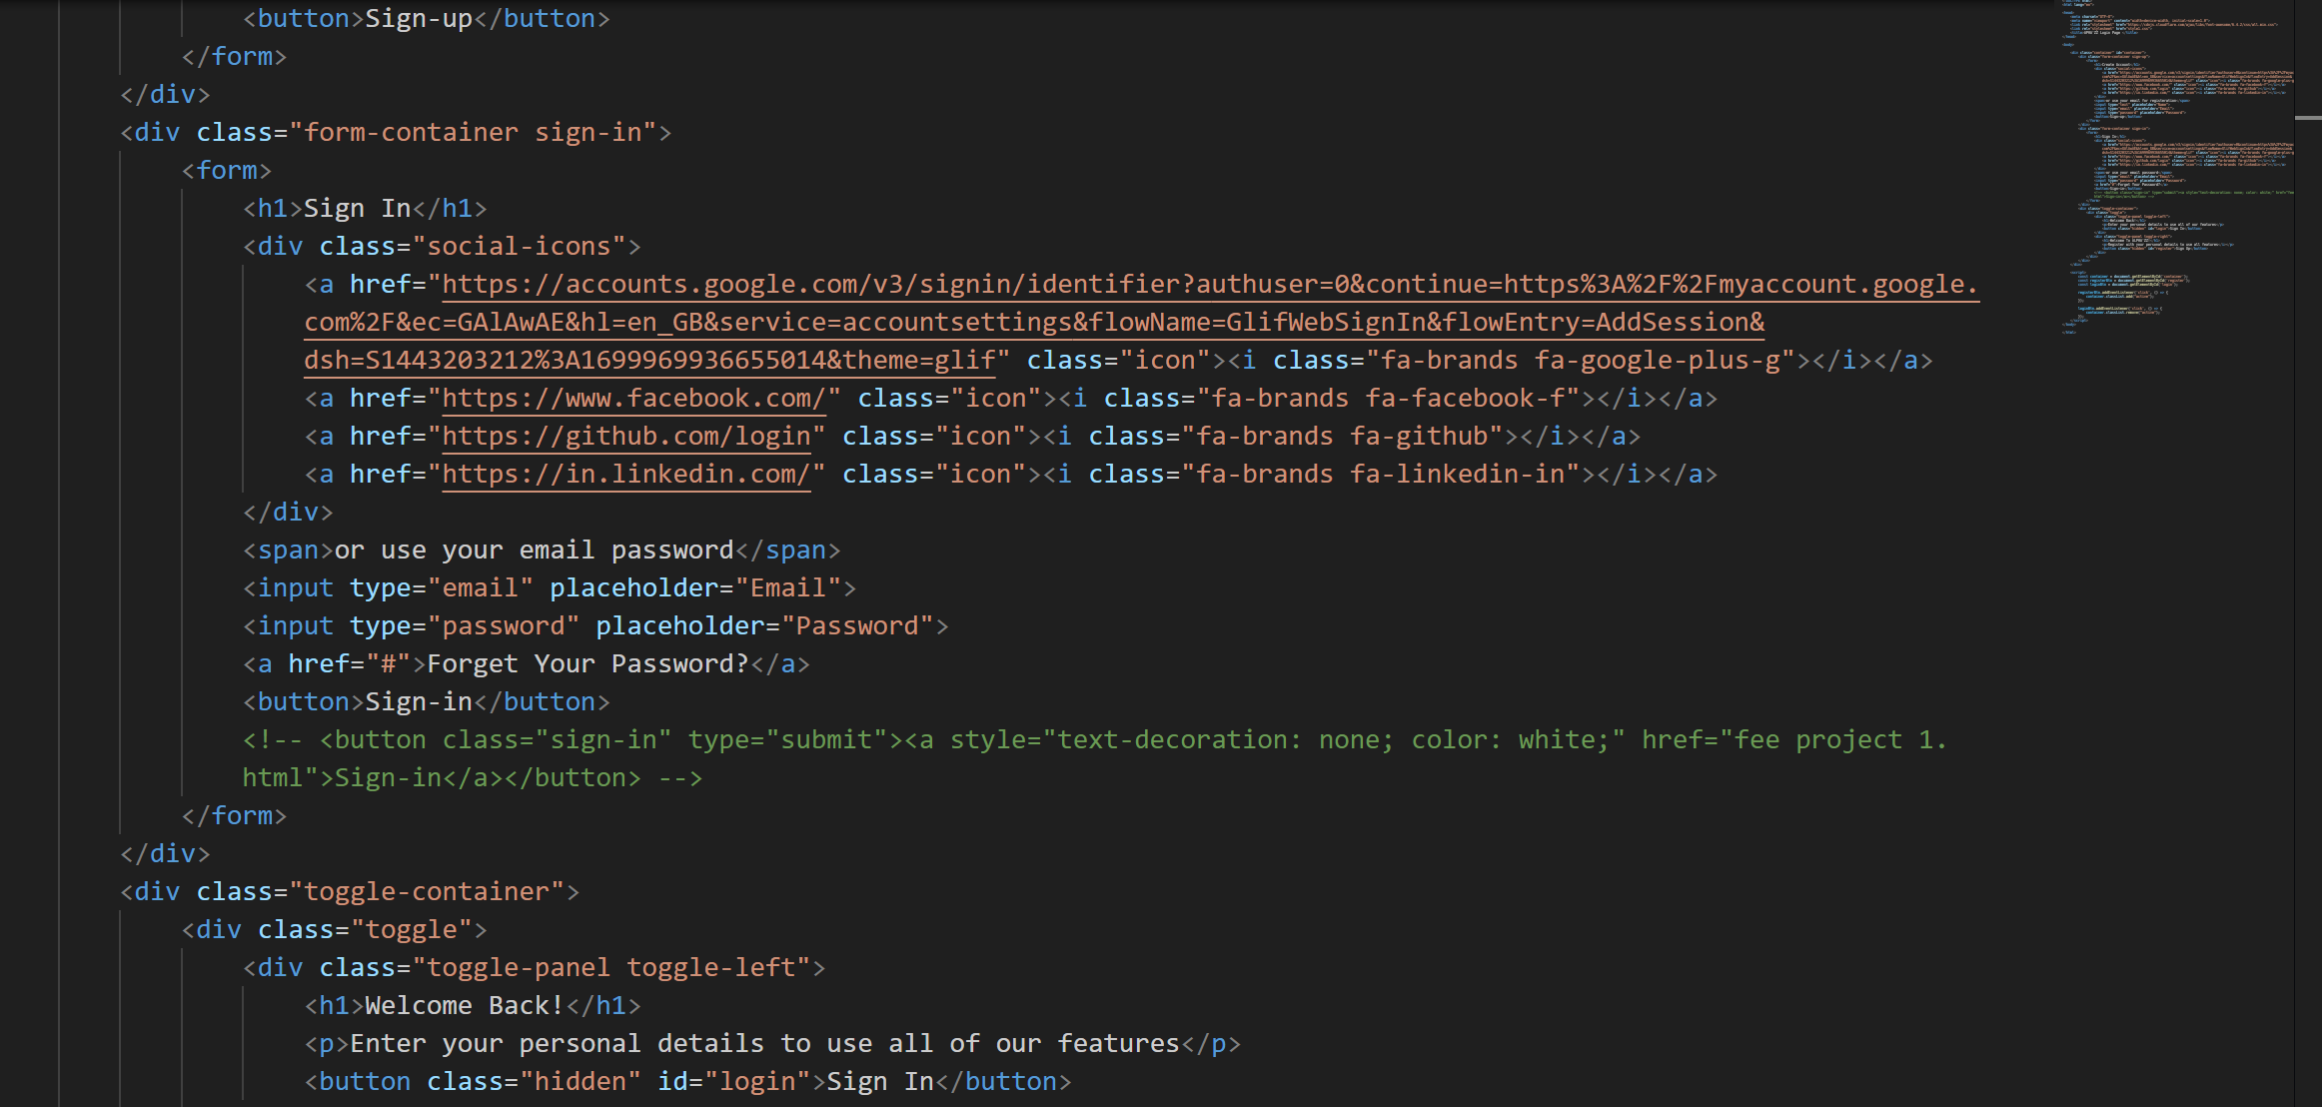
Html Code Highlights

Slide 13
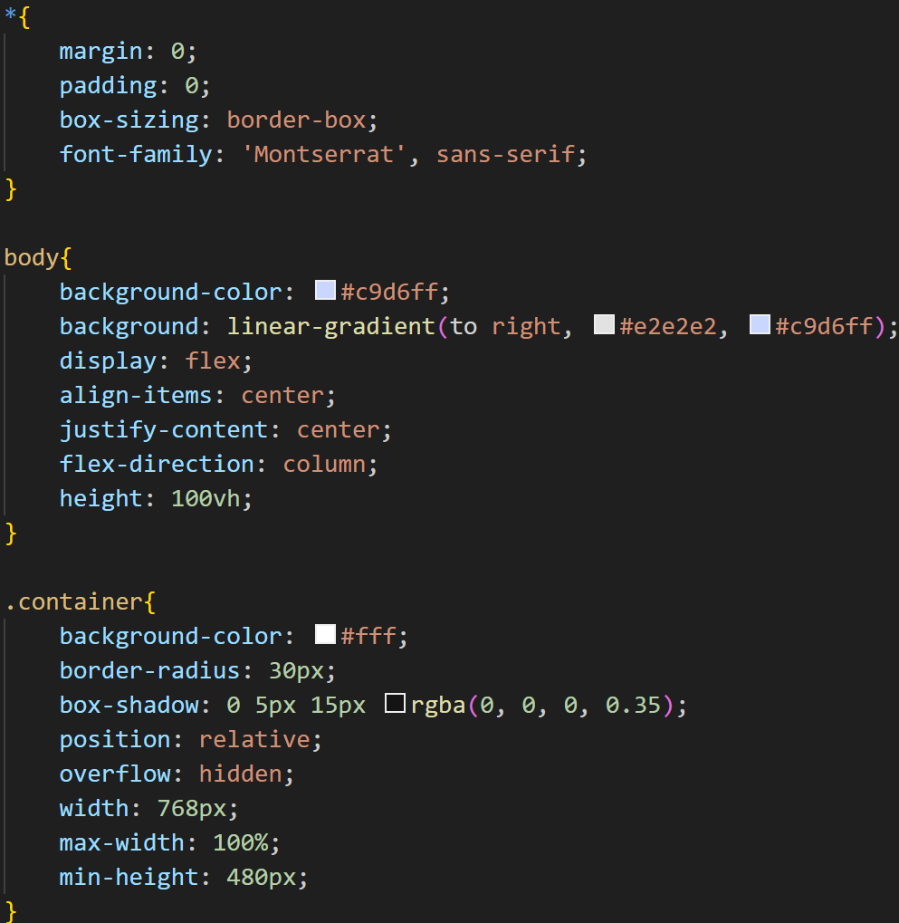
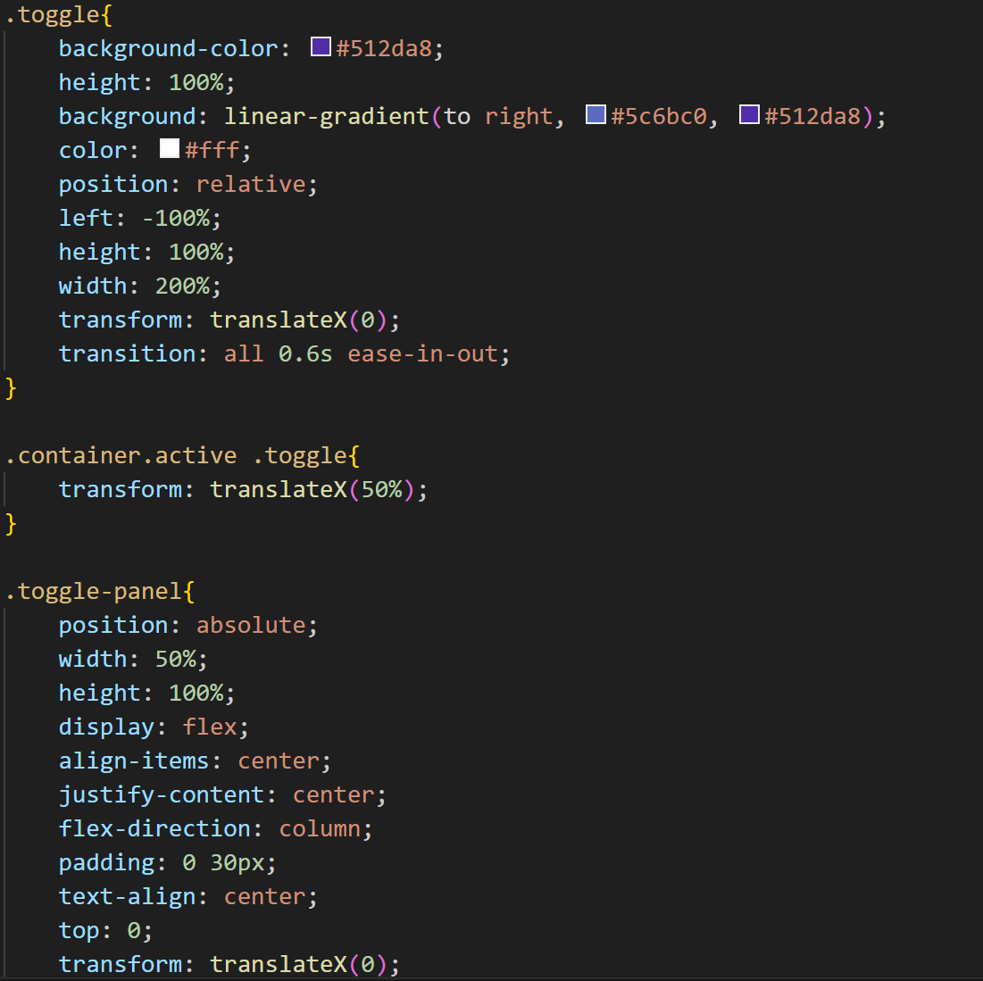
CSS Code Highlights

Slide 14
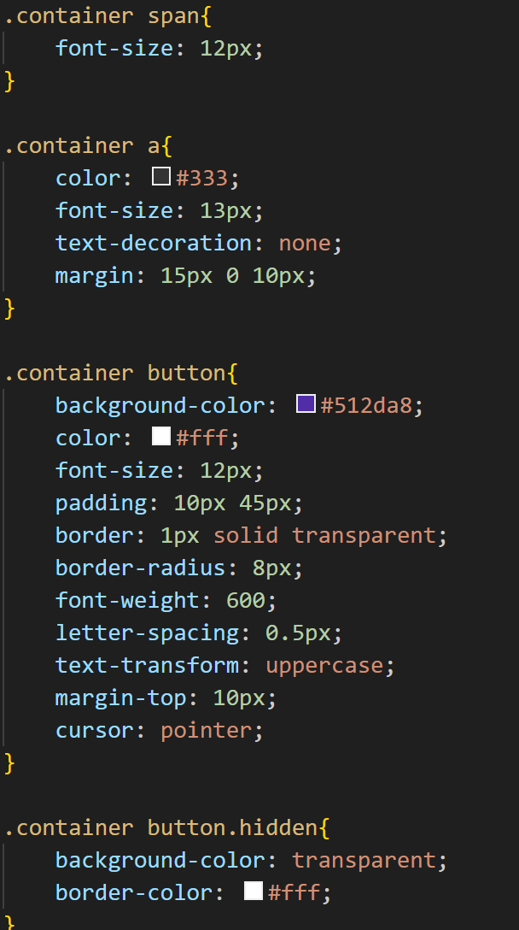
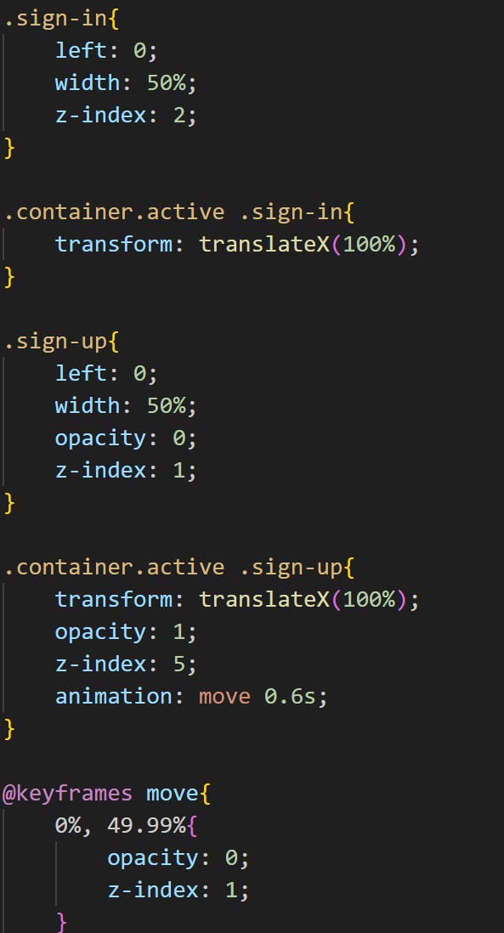
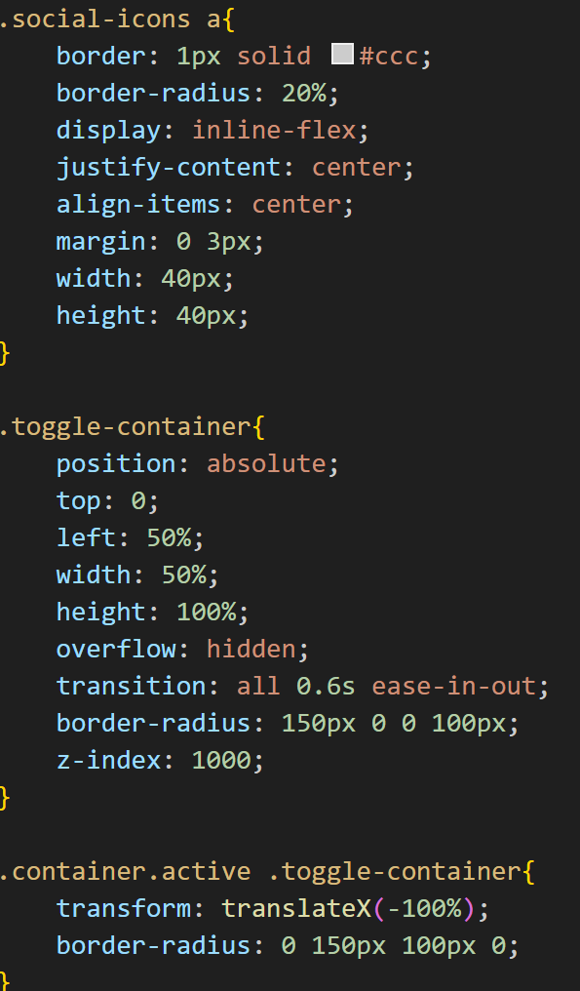
CSS Code Highlights

Slide 15
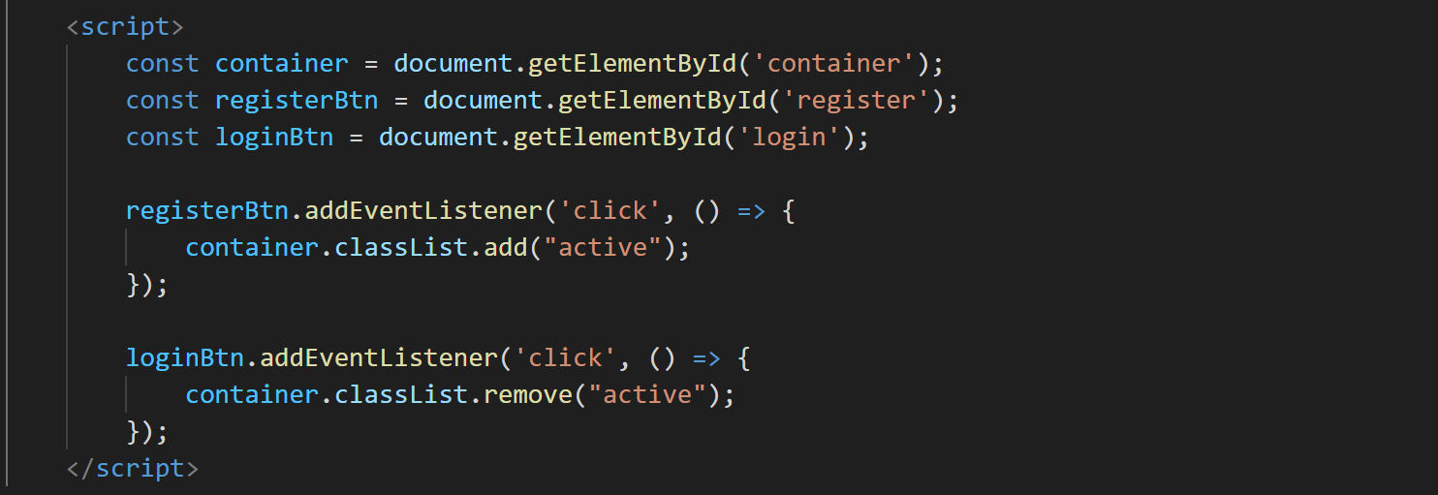
Java Code Highlights

Slide 16
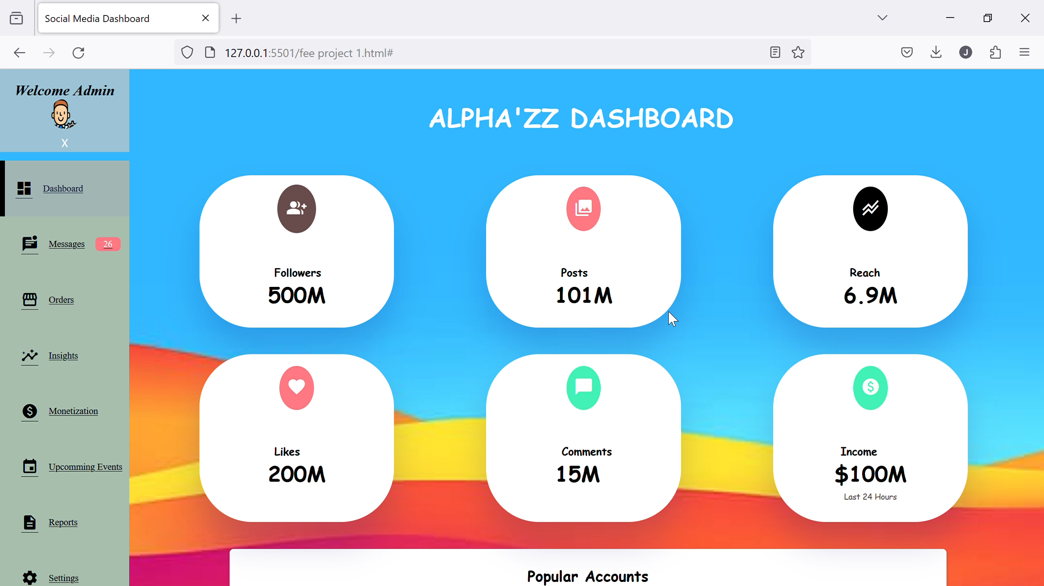
DASHBOARD OVERVIEW

Slide 17
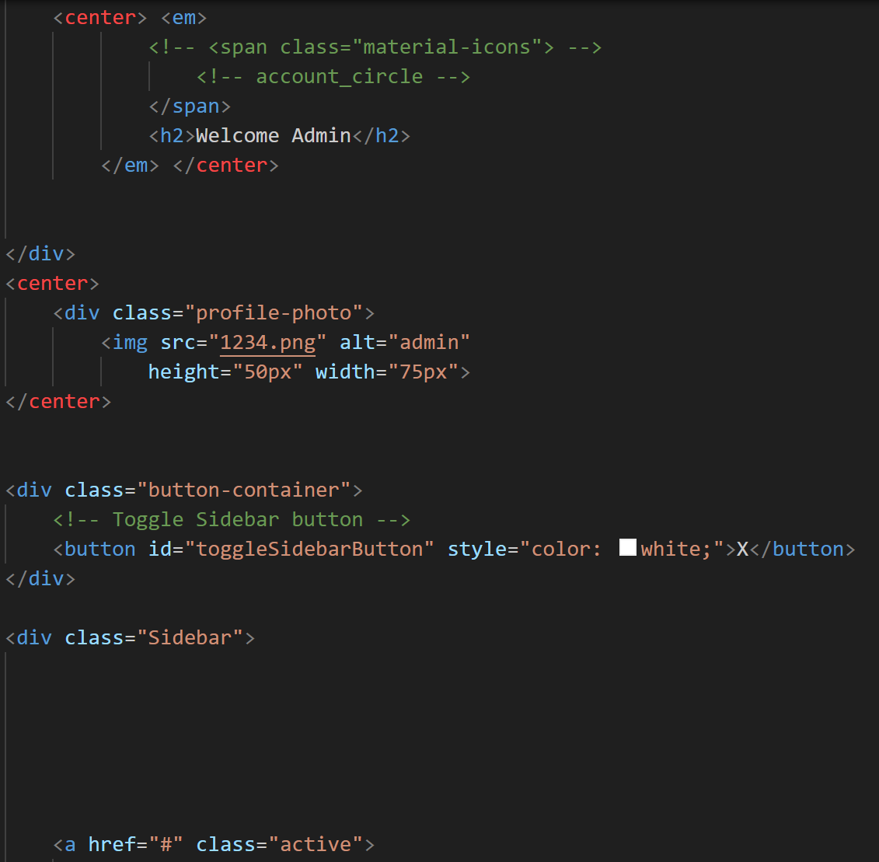
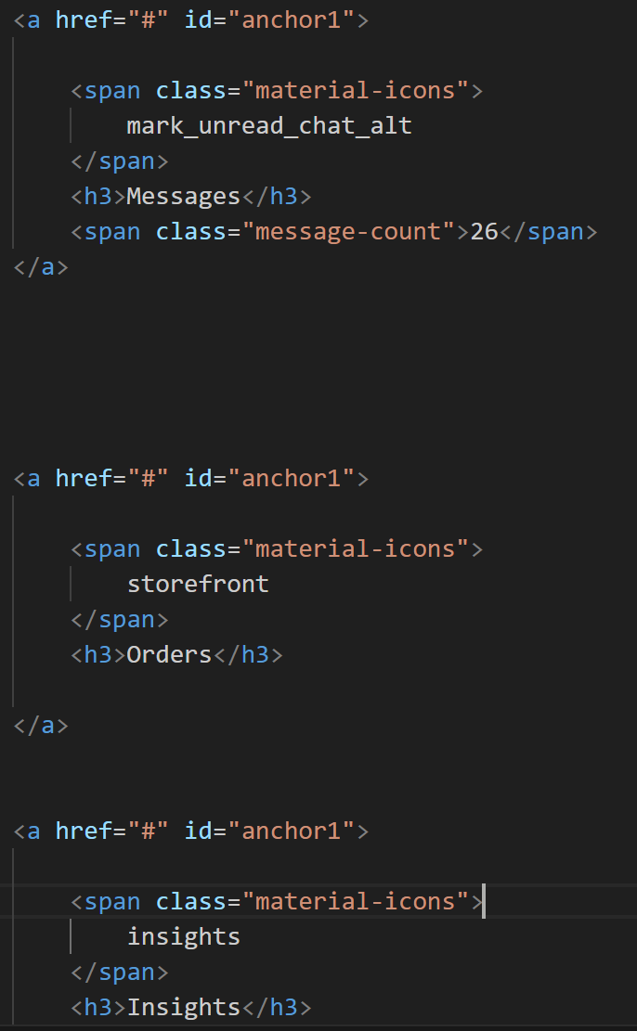
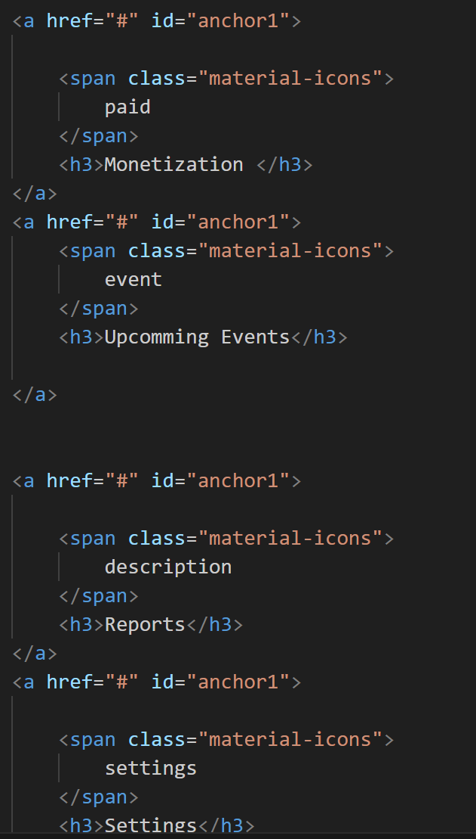
Html Code Highlights

Slide 18
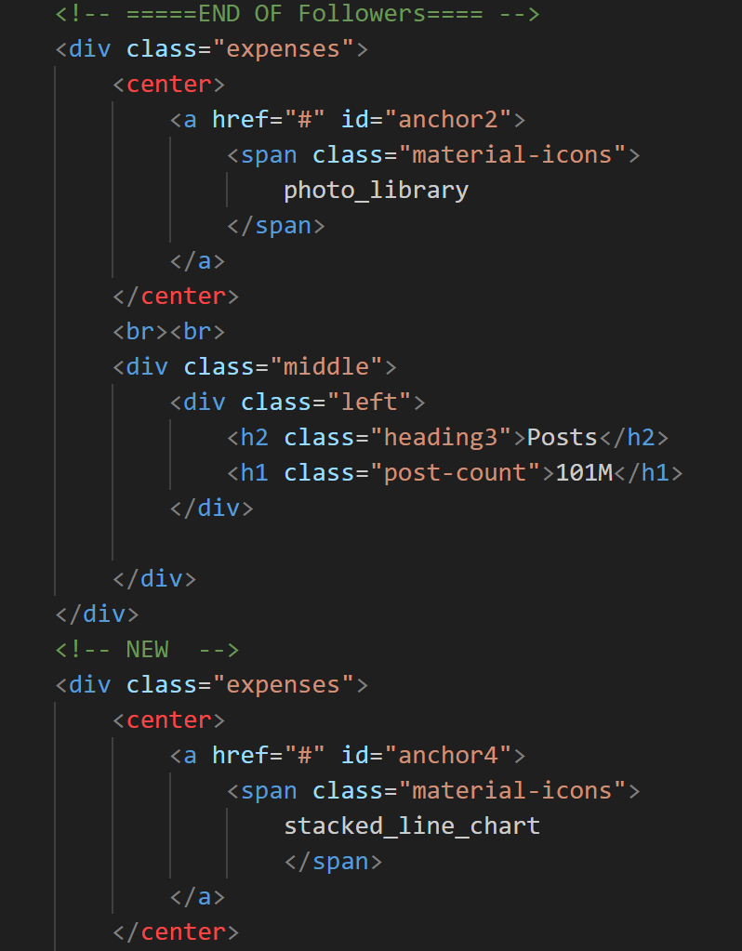
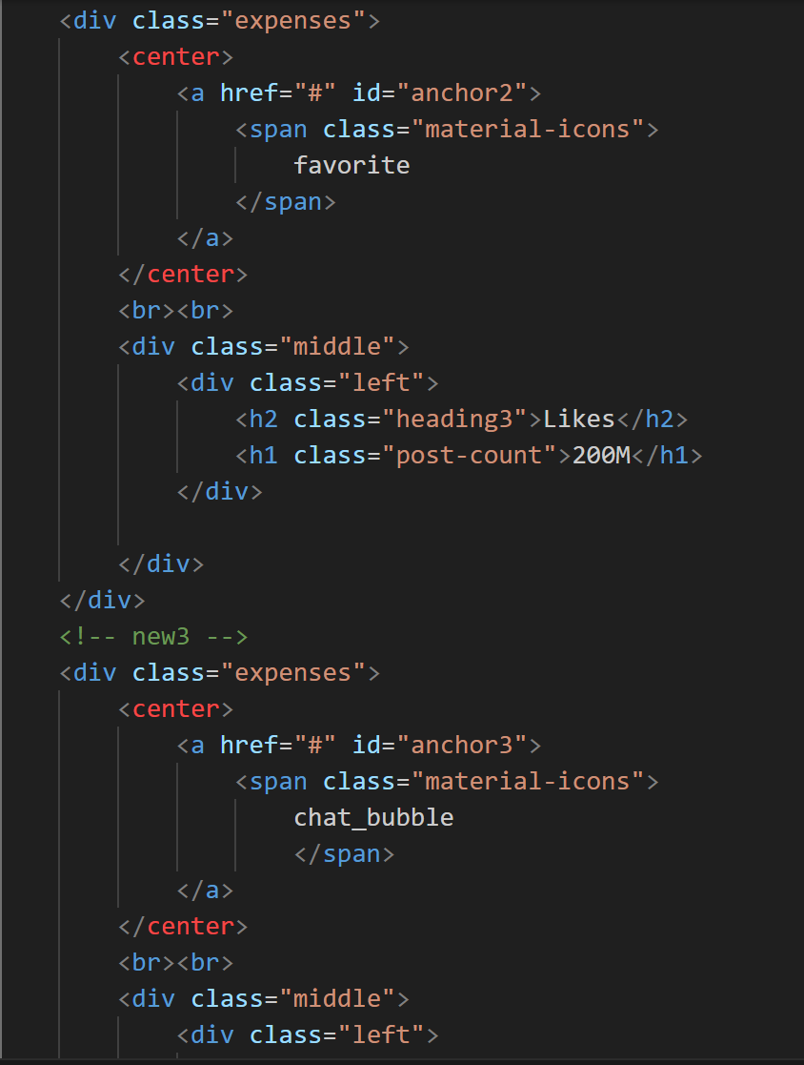
Html Code Highlights

Slide 19
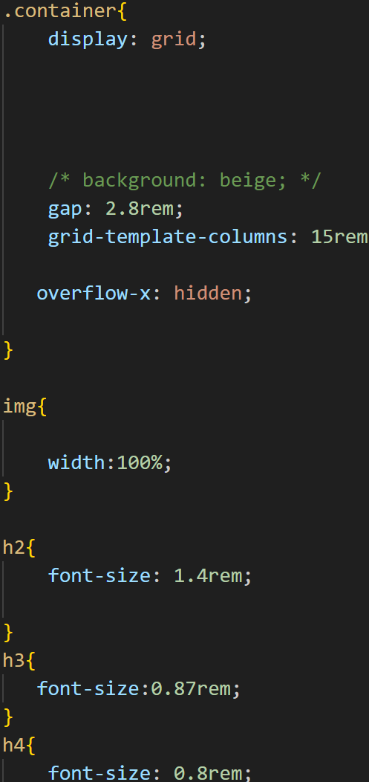
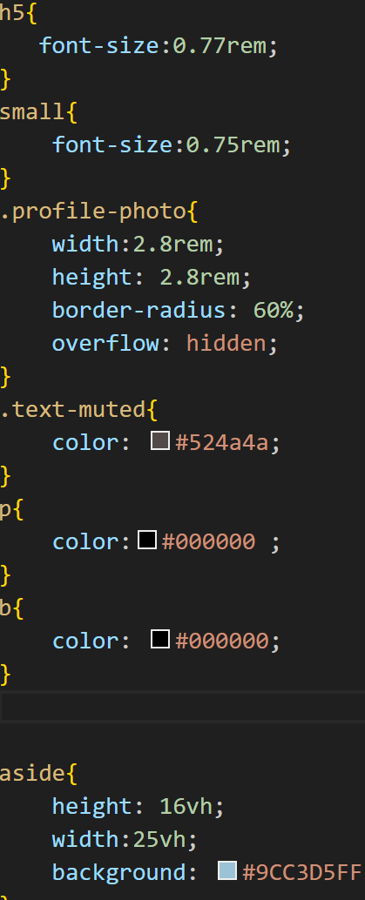
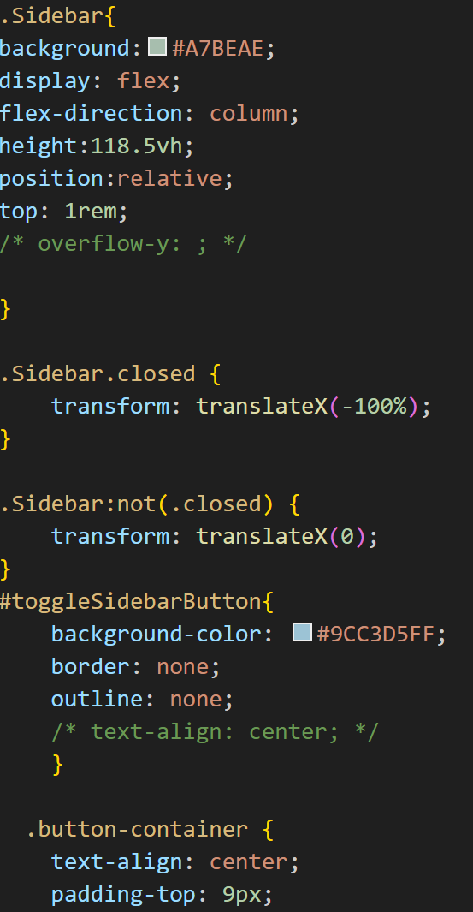
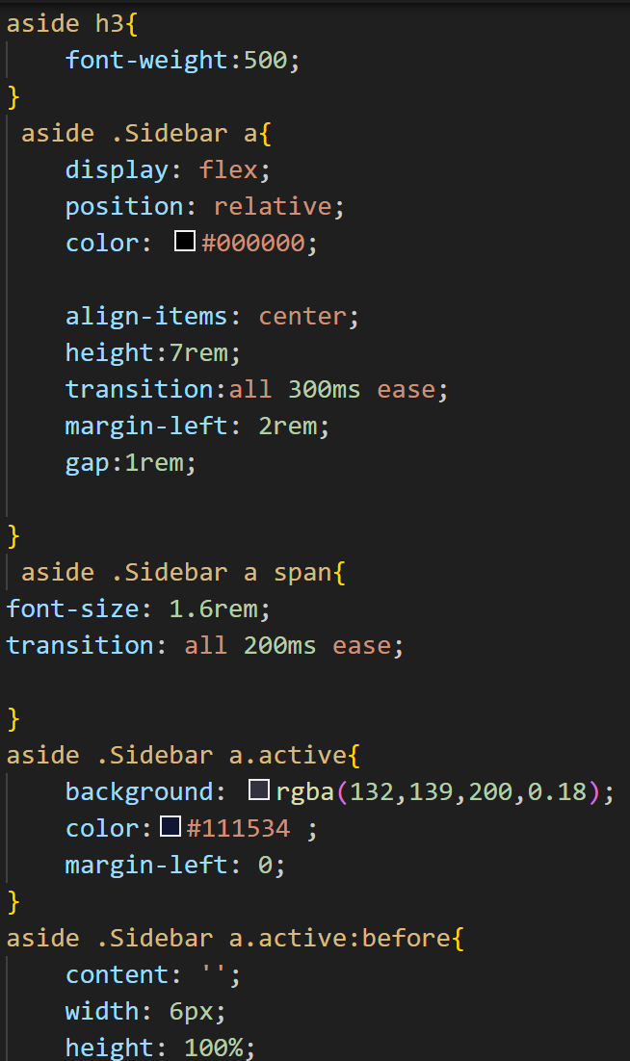
CSS Code Highlights

Slide 20
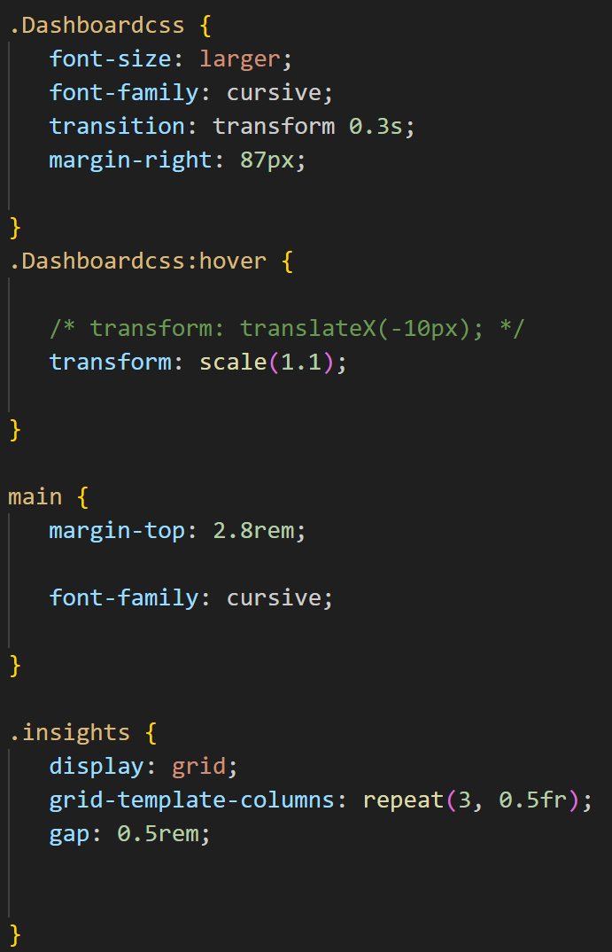
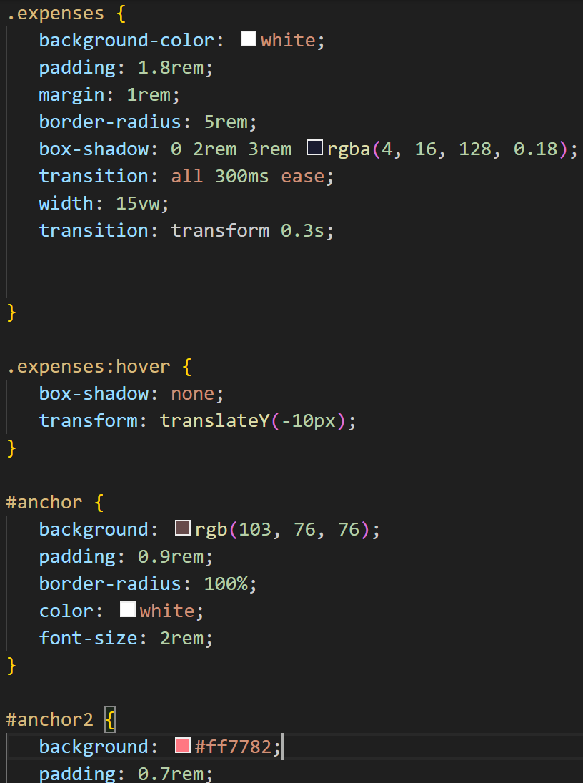
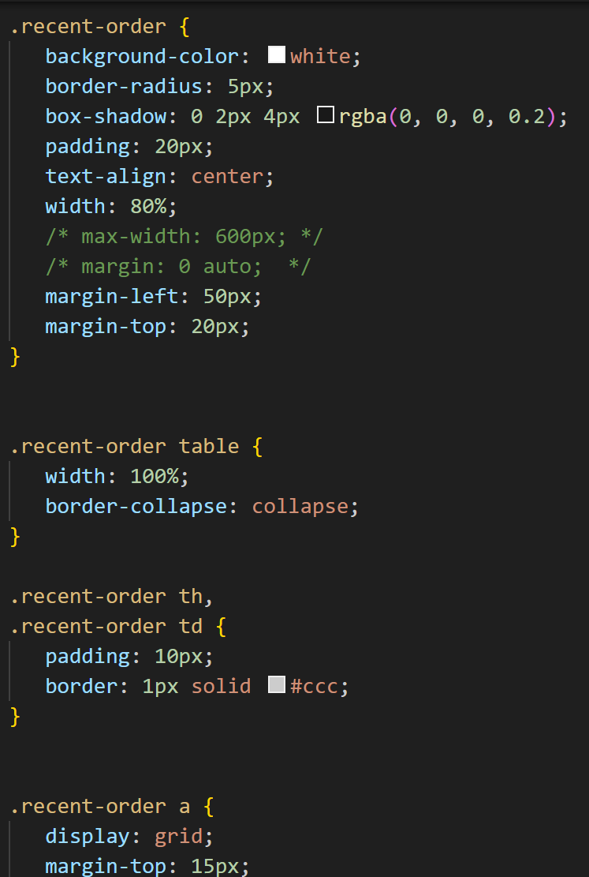
CSS Code Highlights

Slide 21
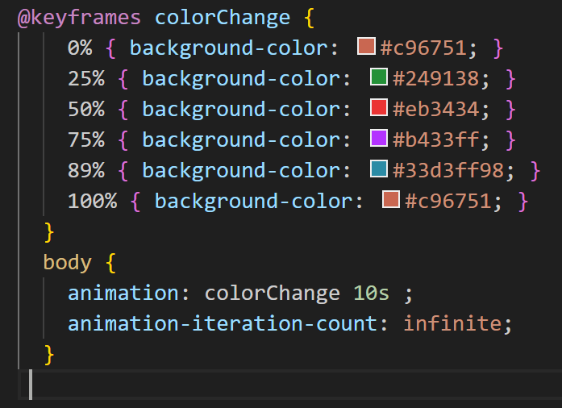
CSS Code Highlights

Slide 22
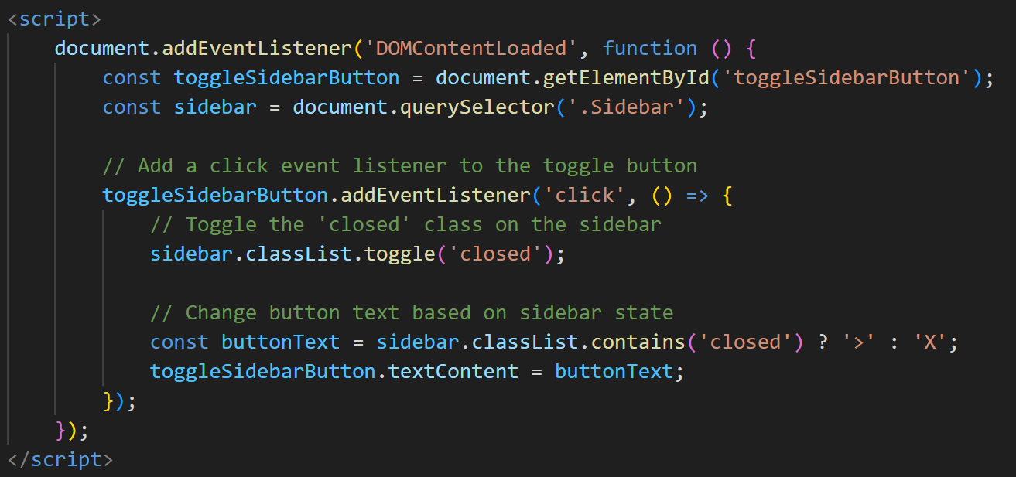
Java Code Highlights

Slide 23
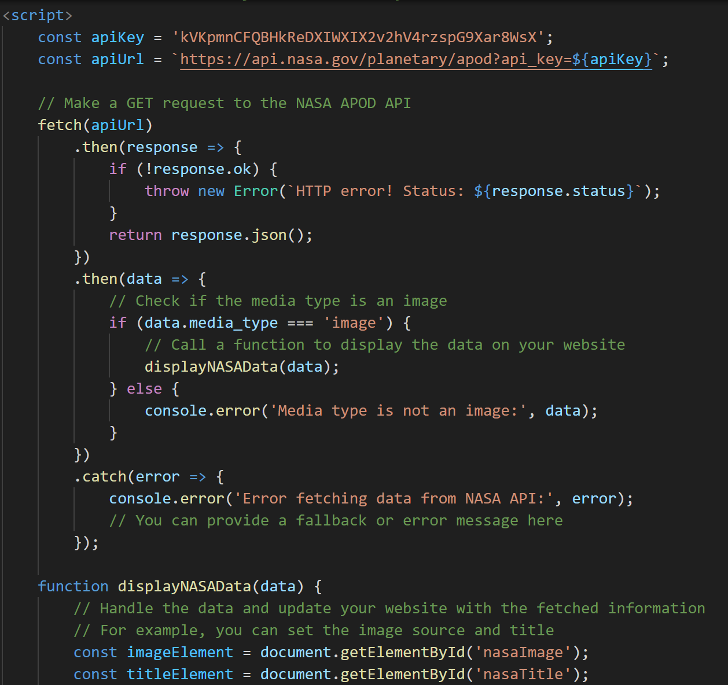
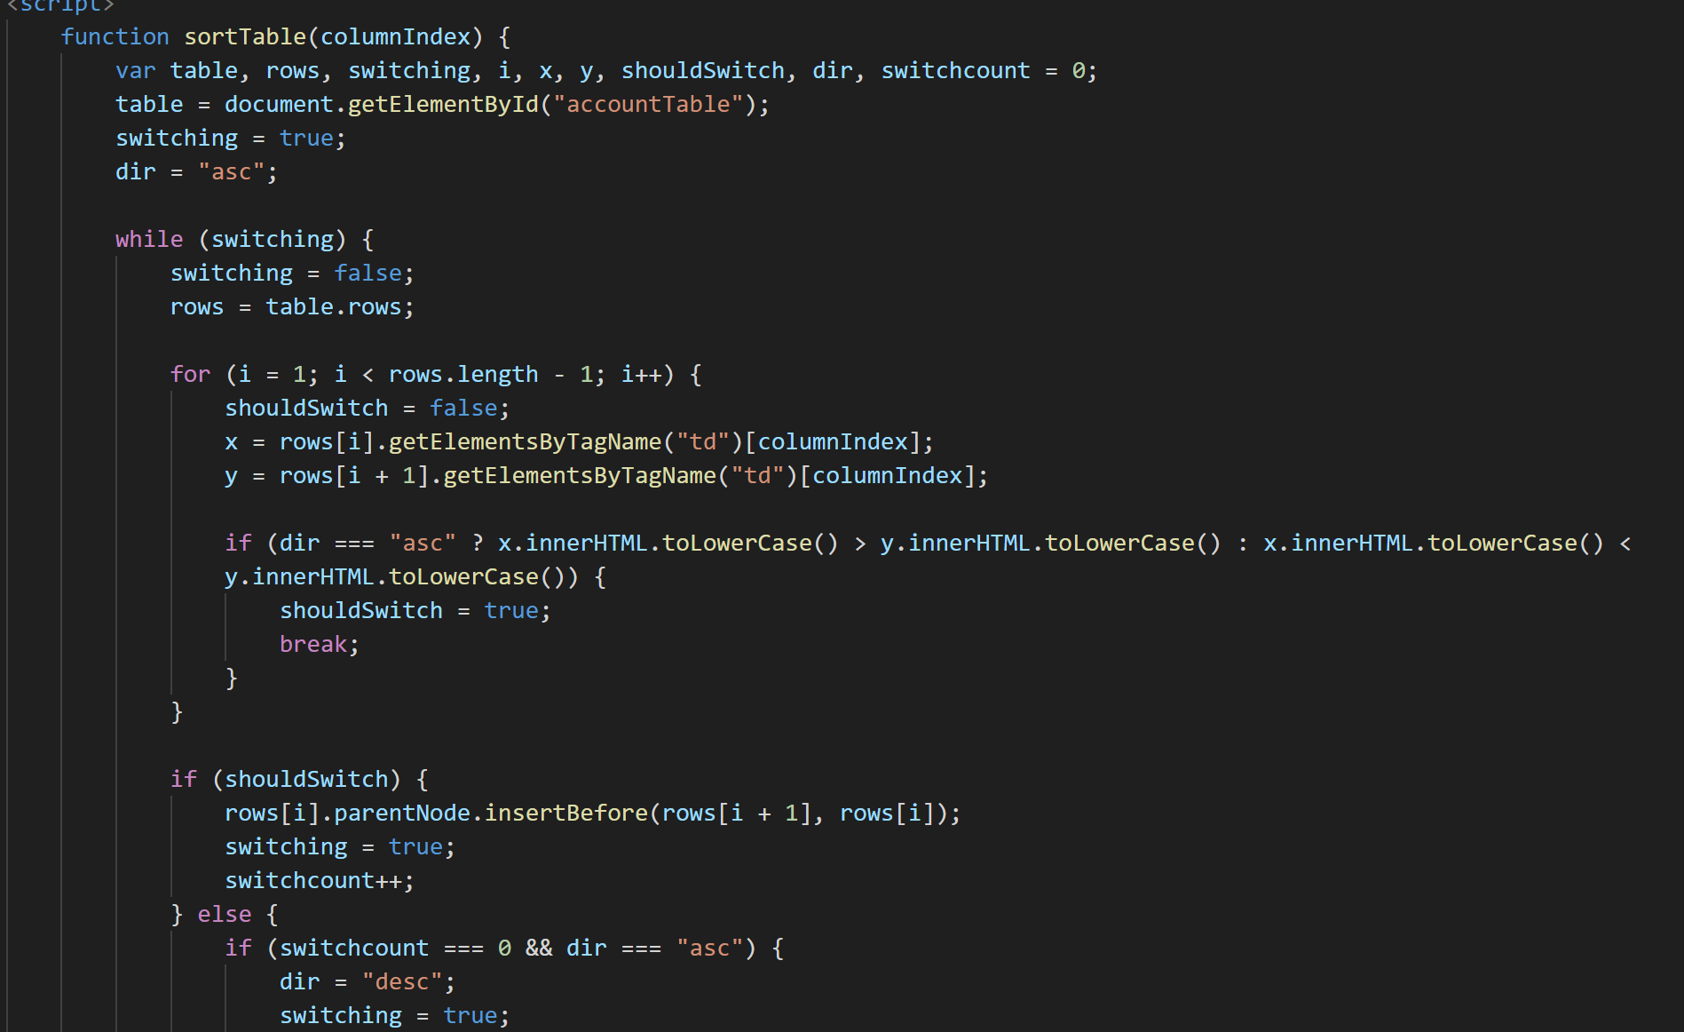
Java Code Highlights

Slide 24
Conclusion
Team Takeaways:
Collaboration: The project strengthened our teamwork and communication skills.
Problem Solving: We learned to overcome challenges and find creative solutions.
Technical Proficiency: Enhanced our expertise in HTML, CSS, and web development.
User-Centric Design: Prioritizing user needs and experience is crucial.
This project has been a valuable learning experience, and we're proud of the results achieved together.

Slide 25



References/Links used
https://stackoverflow.com
https://www.w3schools.com/
https://www.geeksforgeeks.org
These sources and references have been instrumental in guiding our project's development and ensuring its reliability and functionality.

Slide 26
Thank you

